Slide 1
Introduction to R and Rstudio (Part 2)

Slide 2
Contents
Basic syntax, variables, Operators, Data types

Slide 3
Basic syntax
Results of calculations can be stored in objects using the assignment operators:
An arrow (<-) formed by a smaller than character and a hyphen without a space!
The equal character (=).
Sample Example
> n <- 15
> n
[1] 15
> a = 12
> a
To see a list of your objects, use ls( ). The ( ) is required, even though there are no arguments.
Use rm to delete objects you no longer need.
> rm(n) #here n is object name
fdndf

Slide 4
Basic syntax
Creating Strings- use either double quote characters or single quotes
> h <- "hello“ or > h <- 'hello'
Other data types are available. You do not need to declare these; they will be assigned automatically.
> q1 <- TRUE # Logical data
> q1
[1] TRUE
> q2 <- F
> q2
[1] FALSE

Slide 5
Variables
Variables are used to store the information to be manipulated and referenced in the R program.
Variables must start with a letter, but may also contain numbers and periods.
The preferred form for variable names is all lower case letters and words separated with dots (variable.name) but variableName is also accepted.
Don't use underscores ( _ ) or hyphens ( - ) in identifiers.
Examples: avg.clicks GOOD avgClicks OK avg_Clicks BAD
Function names have initial capital letters and no dots (e.g., FunctionName).

Slide 6

Data types

Slide 7
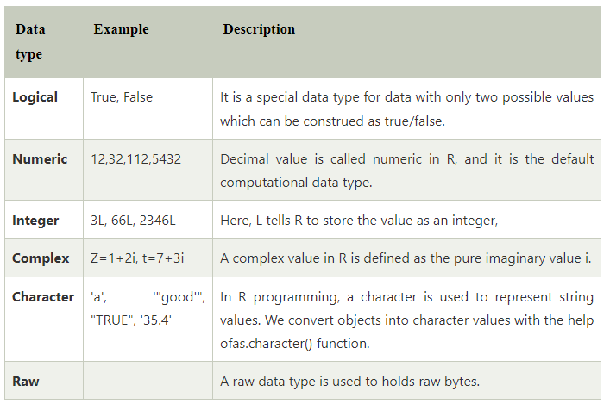
Data types

Slide 8
Practice Examples
#Logical Data type
variable_logical<- TRUE
cat(variable_logical,"\n")
cat("The data type of variable_logical is ",class(variable_logical),"\n\n")
#Numeric Data type
variable_numeric<- 3532
cat(variable_numeric,"\n")
cat("The data type of variable_numeric is ",class(variable_numeric),"\n\n")
#Integer Data type
variable_integer<- 133L
cat(variable_integer,"\n")
cat("The data type of variable_integer is ",class(variable_integer),"\n\n")
Notes:
The simple printing method in R is to use print() . As its name indicates, this method prints its arguments on the R console. However, cat() does the same thing but is valid only for atomic types (logical, integer, real, complex, character) and names

Slide 9
Practice Examples
#Complex Data type
variable_complex<- 3+2i
cat(variable_complex,"\n")
cat("The data type of variable_complex is ",class(variable_complex),"\n\n")
#Character Data type
variable_char<- "Learning r programming"
cat(variable_char,"\n")
cat("The data type of variable_char is ",class(variable_char),"\n\n")
#Raw Data type
variable_raw<- charToRaw("Learning r programming")
cat(variable_raw,"\n")
cat("The data type of variable_char is ",class(variable_raw),"\n\n")

Slide 10
Operators
Arithmetic Operators
Relational Operators
Logical Operators
Assignment Operators
Miscellaneous Operators

Slide 11
Operators
R may be used for simple calculation, using the standard arithmetic symbols +, -, *, /, as well as parentheses and ^ (exponentiation).
> a <- 12+14
> a
[1] 26
> 3*5
[1] 15
> (20-4)/2
[1] 8
> 7^2
[1] 49

Slide 12
Standard mathematical functions
Standard mathematical functions are available.
> exp(2)
[1] 7.389056
> log(10) # Natural log
[1] 2.302585
> log10(10) # Base 10
[1] 1
> log2(64) # Base 2
[1] 6

Slide 13
Standard mathematical functions
> pi
[1] 3.141593
> cos(pi)
[1] -1
> sqrt(100)
[1] 10

Slide 14
Operators
A relational operator is a symbol which defines some kind of relation between two entities. These include numerical equalities and inequalities. A relational operator compares each element
> x=5
> y=45
> print(x>y)
[1] FALSE
> print(x<y)
[1] TRUE
> print(x>=y)
[1] FALSE
> print(x<=y)
[1] TRUE
> print(x==y)
[1] FALSE
> print(x!=y)
[1] TRUE

Slide 15
Operators
The logical operators allow a program to make a decision on the basis of multiple conditions.
> x=5
> y=45
> print(x&y)
[1] TRUE
print(x|y)
[1] TRUE
> print(!y)
[1] FALSE
Notes:
and:-&-returns TRUE if both the elements are TRUE.
Or-|-returns TRUE if one of them is TRUE.
Not-!- gives the opposite logical value as a result.

Slide 16
Operators
An assignment operator is used to assign a new value to a variable.
> a <- 25
> a
[1] 25
> a = 12
> a
[1] 12
> 24 -> x
> x
[1] 24
Notes:
and:-&-returns TRUE if both the elements are TRUE.
Or-|-returns TRUE if one of them is TRUE.
Not-!- gives the opposite logical value as a result.

Slide 17
Operators
Miscellaneous operators are used for a special and specific purpose.
> a <- 1:5
> a
[1] 1 2 3 4 5
>x1 <- 5
>x2 <- 10
>d <- 1:7
>print(x1%in%d)
[1] TRUE
>print(x2%in%d)
[1]FALSE
Notes:
: The colon operator is used to create the series of numbers in sequence.
%in% This is used when we want to identify if an element belongs to a vector.
%*% It is used to multiply a matrix with its transpose.

Slide 18
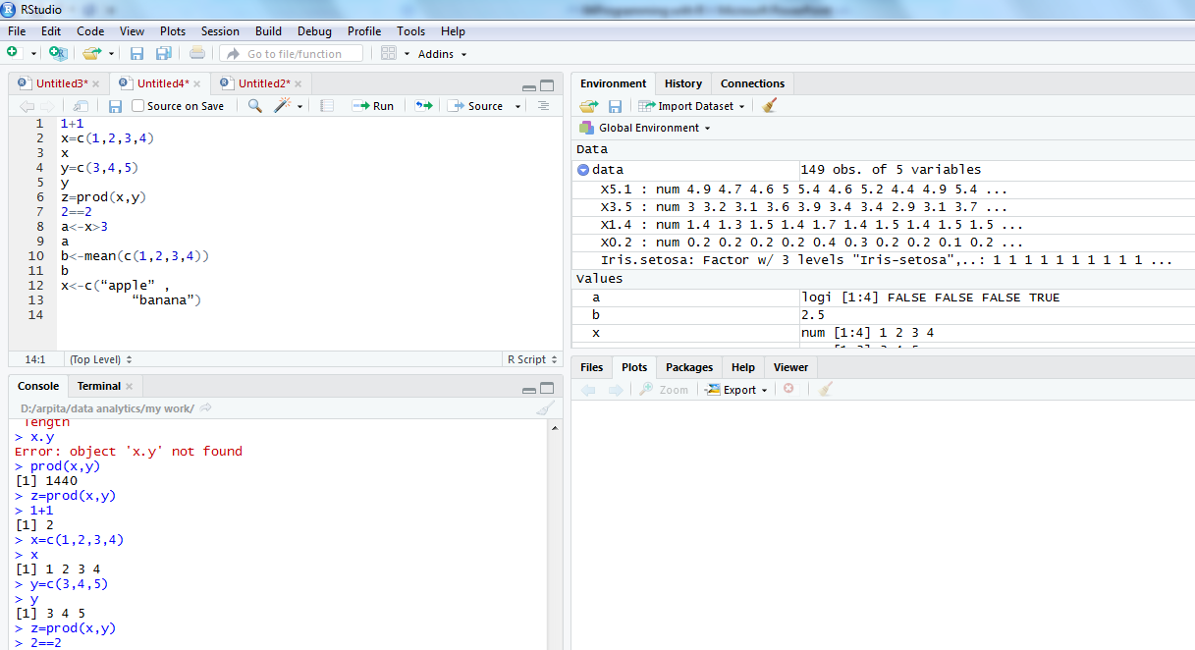
R commands in integrated environment

Slide 19
Practice Examples
> 3+5
> 12 + 3 / 4 – 5 + 3*8
> (12 + 3 / 4 – 5) + 3*8
> pi * 2^3 – sqrt(4)
>factorial(4)
>log(2,10)
>log(2, base=10)
>log10(2)
>log(2)
Note
R ignores spaces

Slide 20
Practice Examples
> x = 3+5
> x
> y = 12 + 3 / 4 – 5 + 3*8
> y
> z = (12 + 3 / 4 – 5) + 3*8
> z
> A <- 6 + 8 ## no space should be between < & -
> a ## Note: R is case sensitive
>A

